Slide 1

Signals and Systems Tutorial 3-2
Yifei Sun
sunyf2019@mail.sustech.edu.cn

Slide 2
Problem 3.11, 3.30, 3.37, 3.49

Slide 3
Reviews
Periodicity Properties of DT Complex Exponentials;
DT Fourier Series Representation;
DT Fourier Series Pair;
DTFS of Periodic Square Wave;
Properties of DT Fourier Series;
Frequency response of LTI system;
Filtering

Slide 4
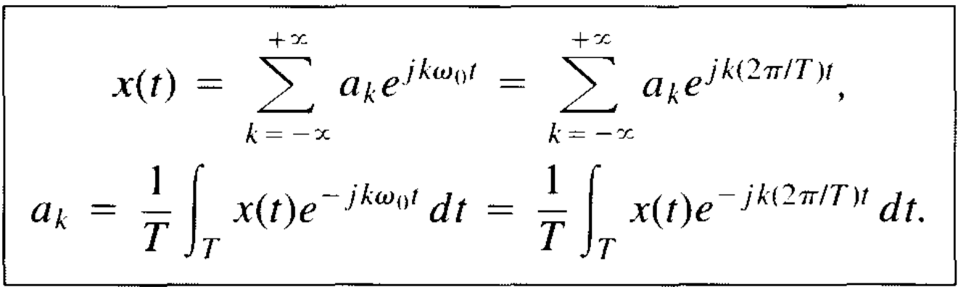
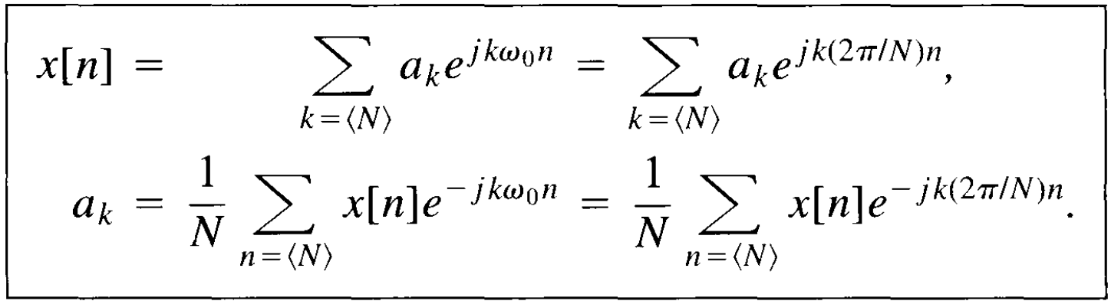
Reviews
CTFS pair DTFS pair

Slide 5
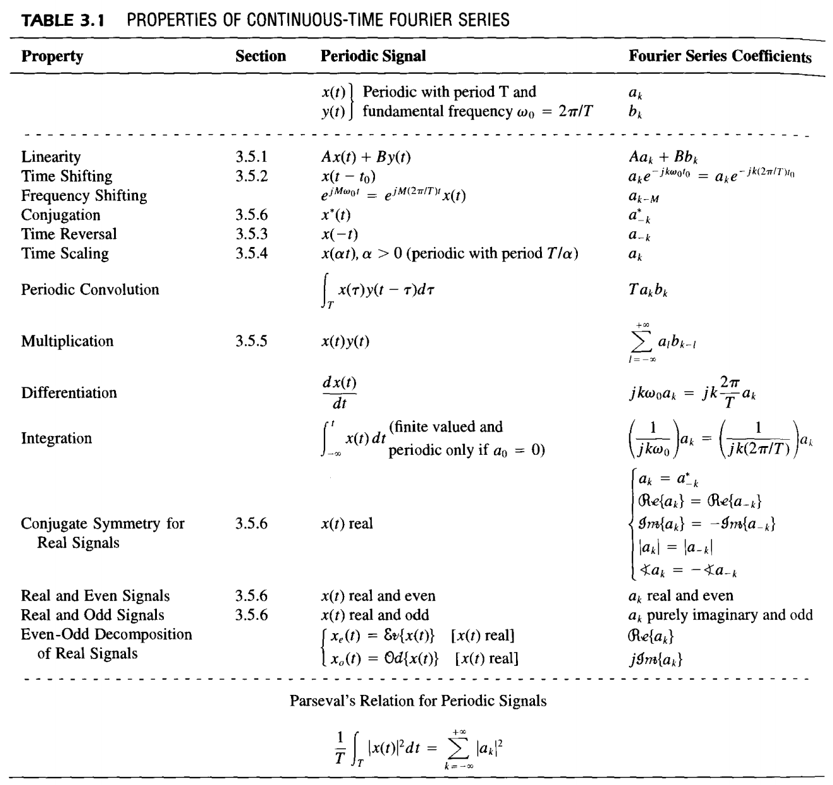
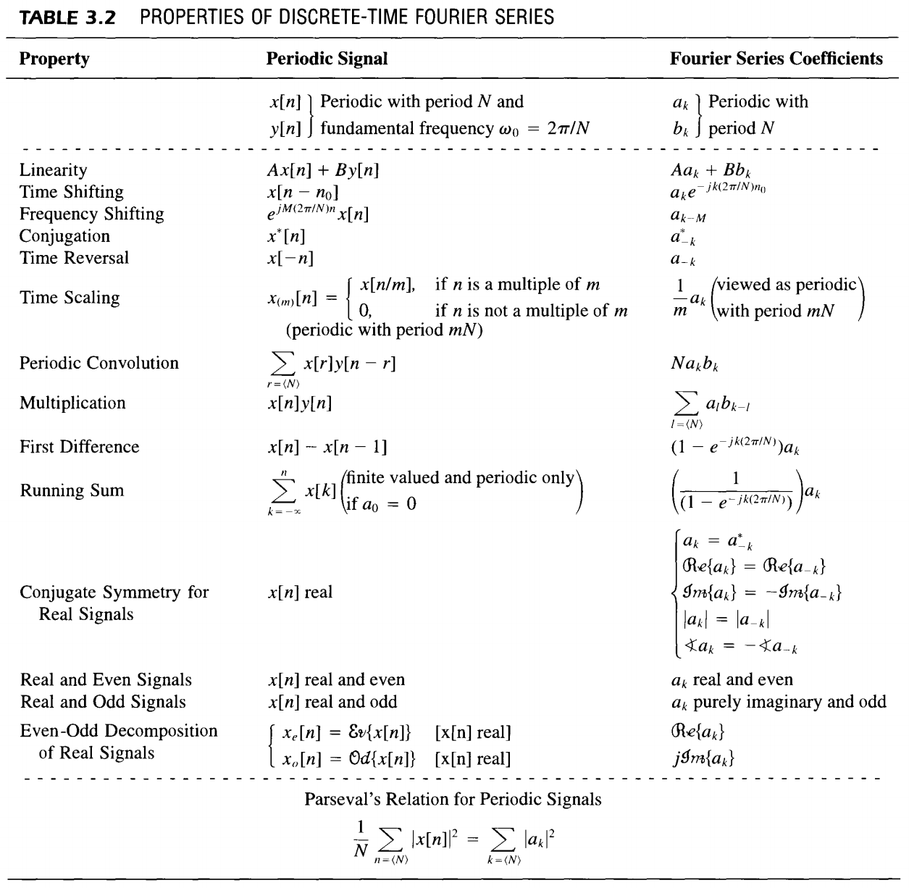
Reviews
CTFS properties DTFS properties

Slide 6
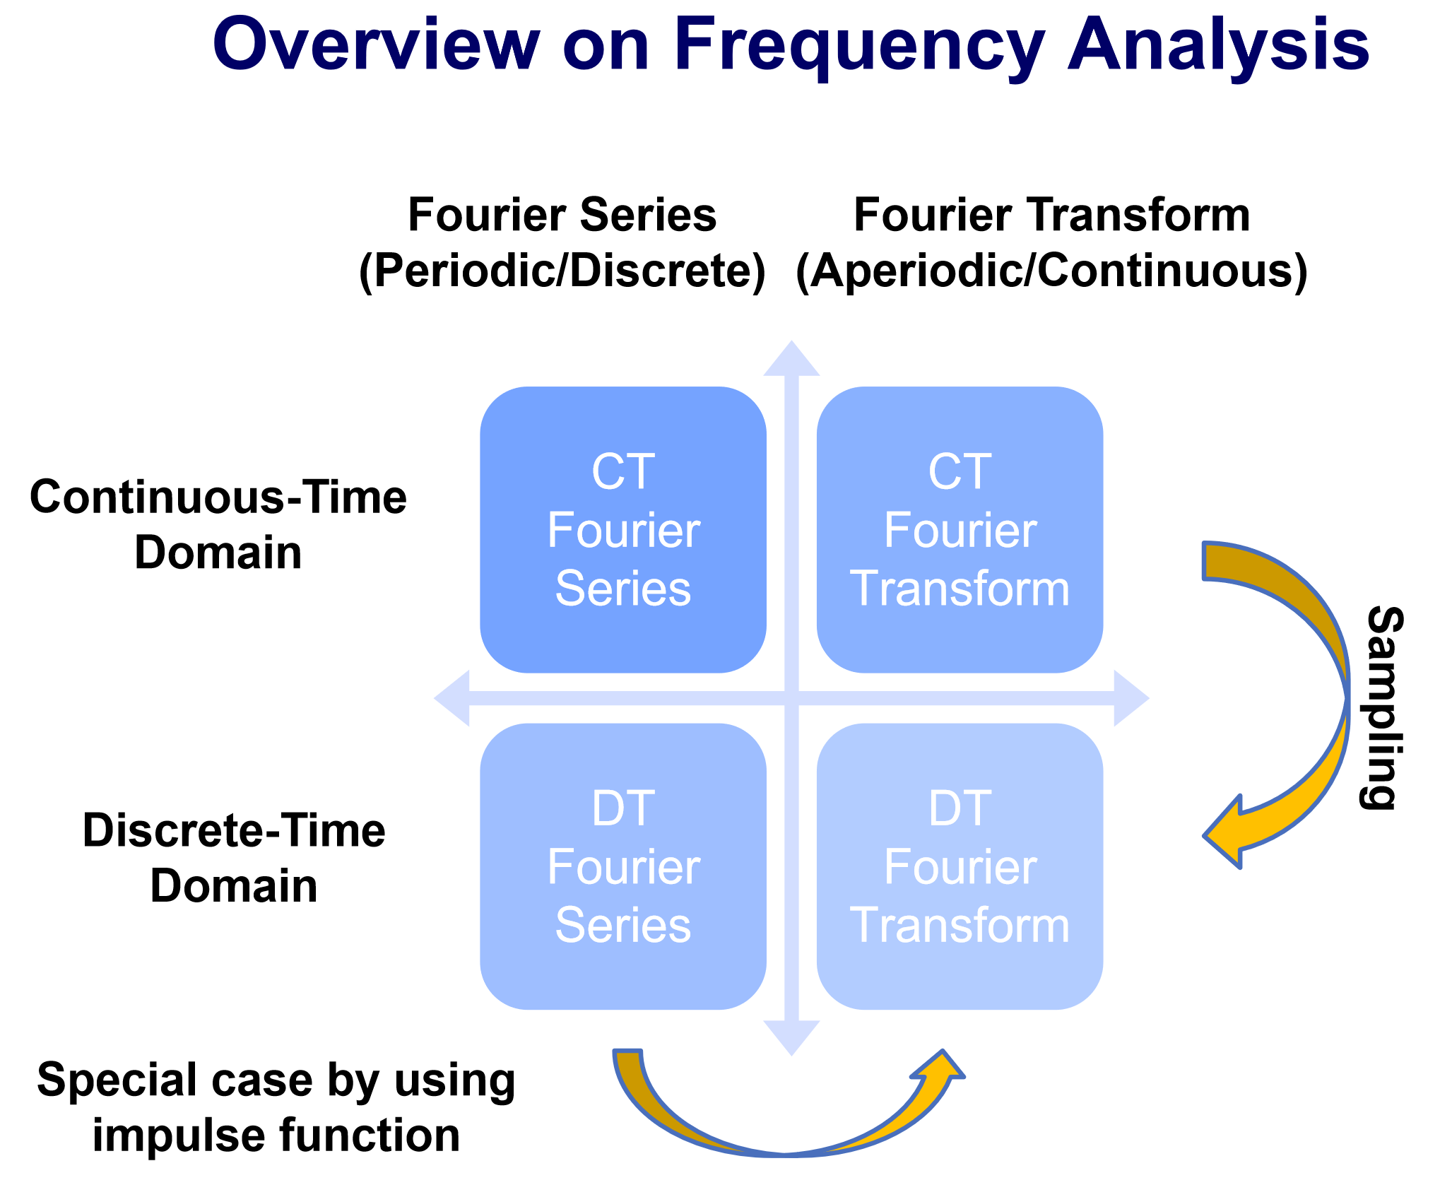
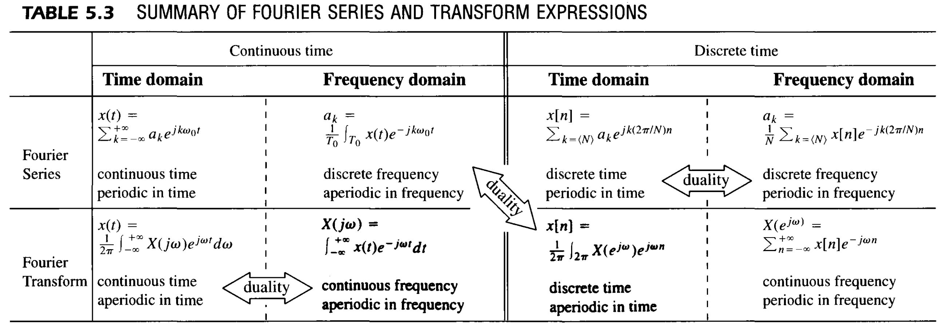
Reviews
CTFS pair DTFS pair
“The duality property for discrete-time Fourier series implies that the Fourier series coefficients for the periodic sequence a_k are the values of (1/N)x[-n] (i.e., are proportional to the values of the original signal, reversed in time).”

Slide 7
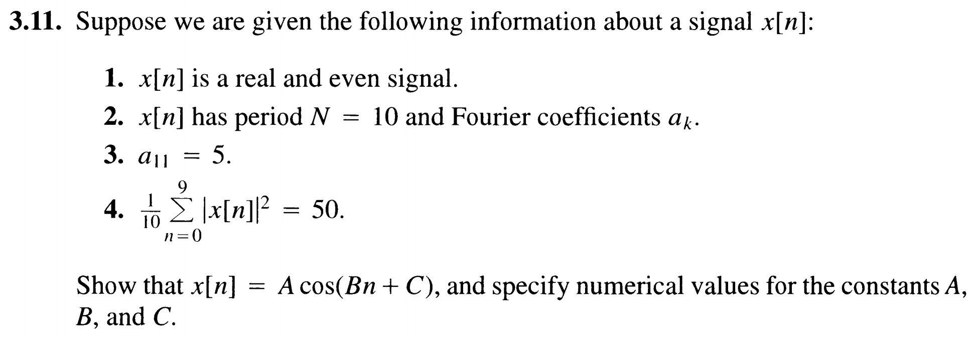
Problem 3.11

Slide 8
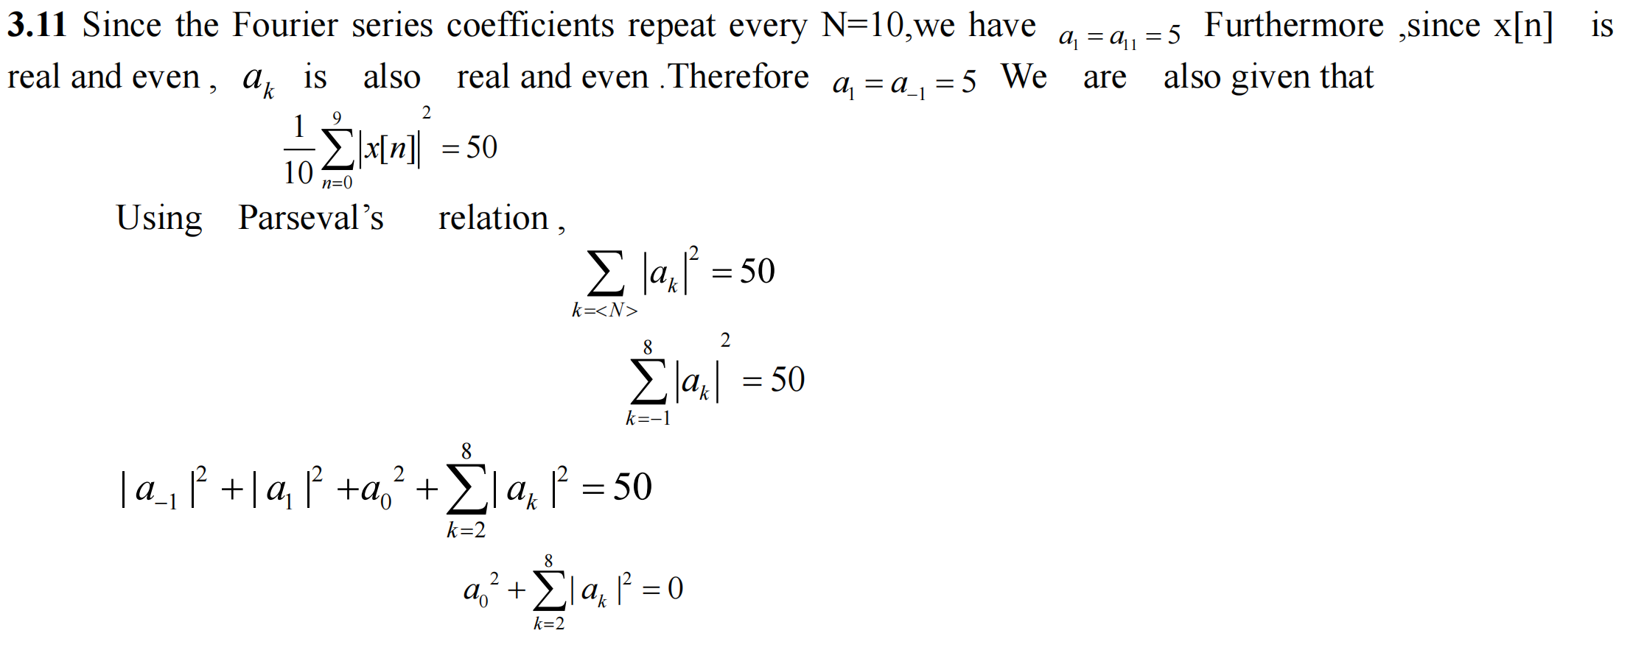
Solution 3.11

Slide 9
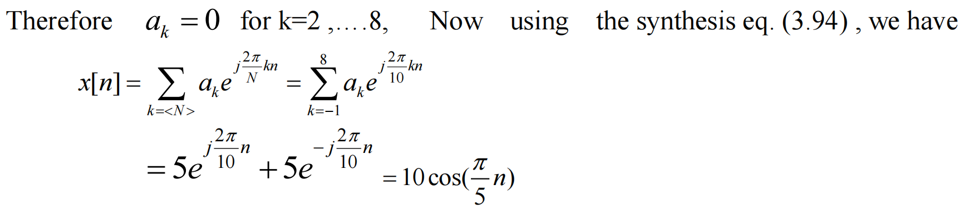
Solution 3.11

Slide 10
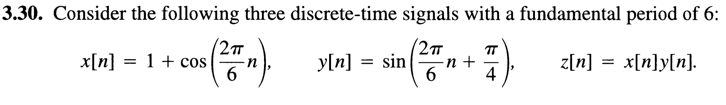
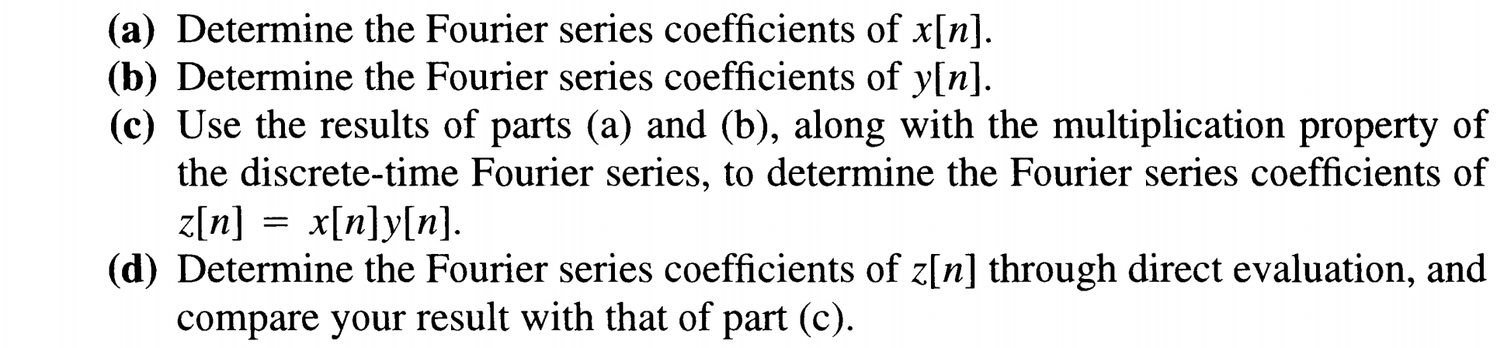
Problem 3.30

Slide 11
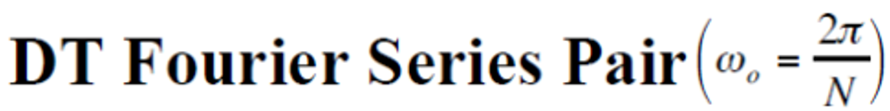

Slide 12
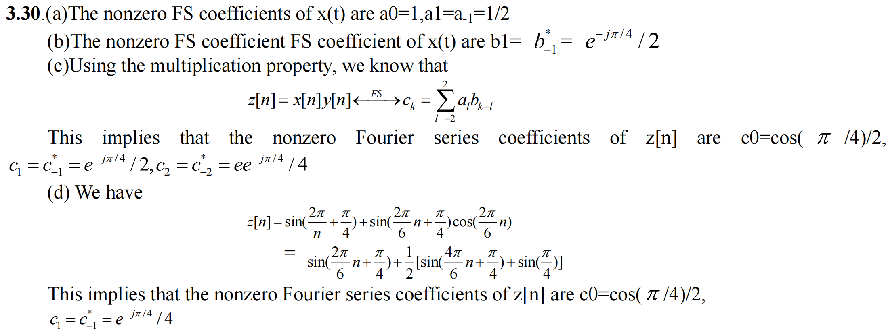
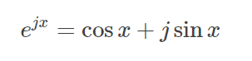
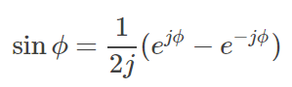
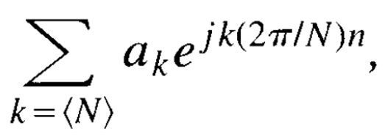
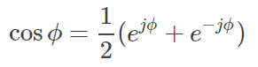
Solution 3.30
e
Euler’s formula:
= ...... (expand sin(x+y) and use Euler’s formula)
= ......（in form of ）

Slide 13
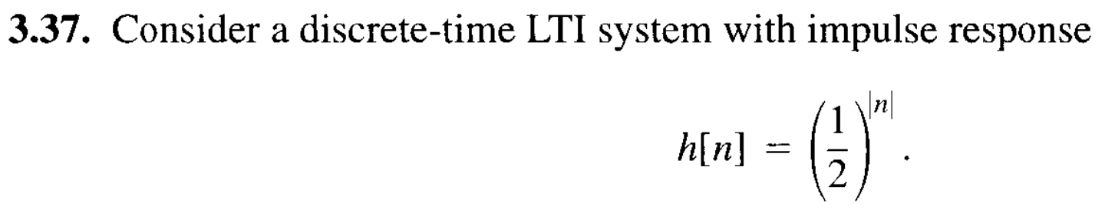
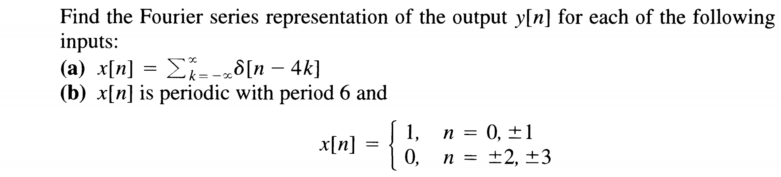
Problem 3.37

Slide 14
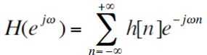
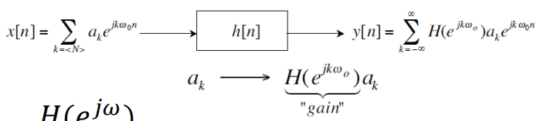


Slide 15
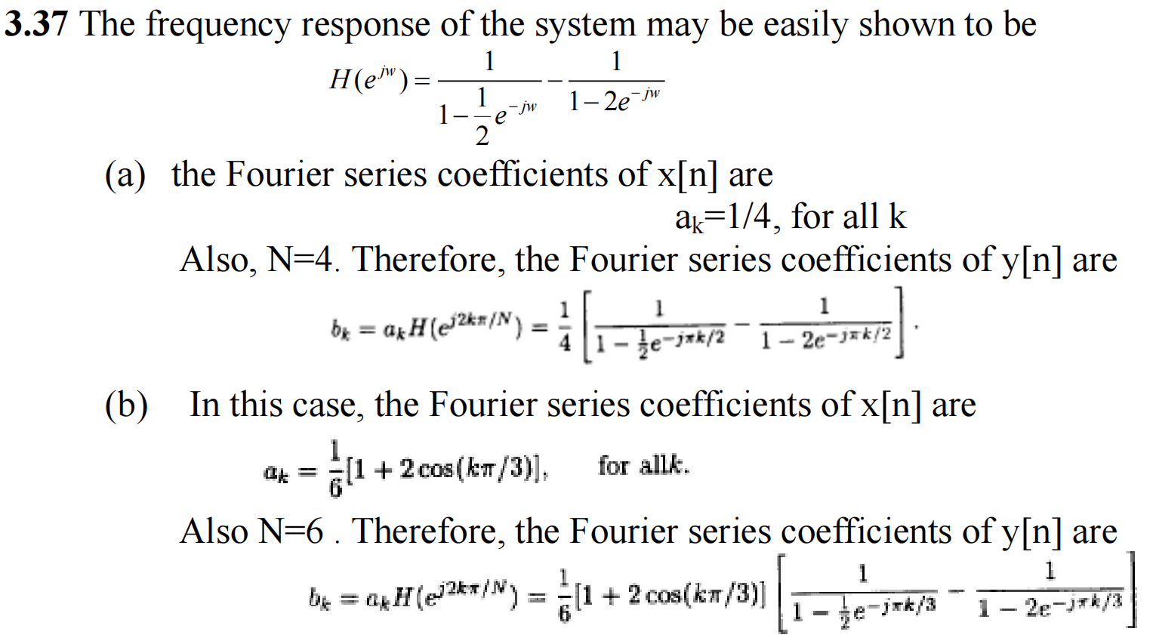
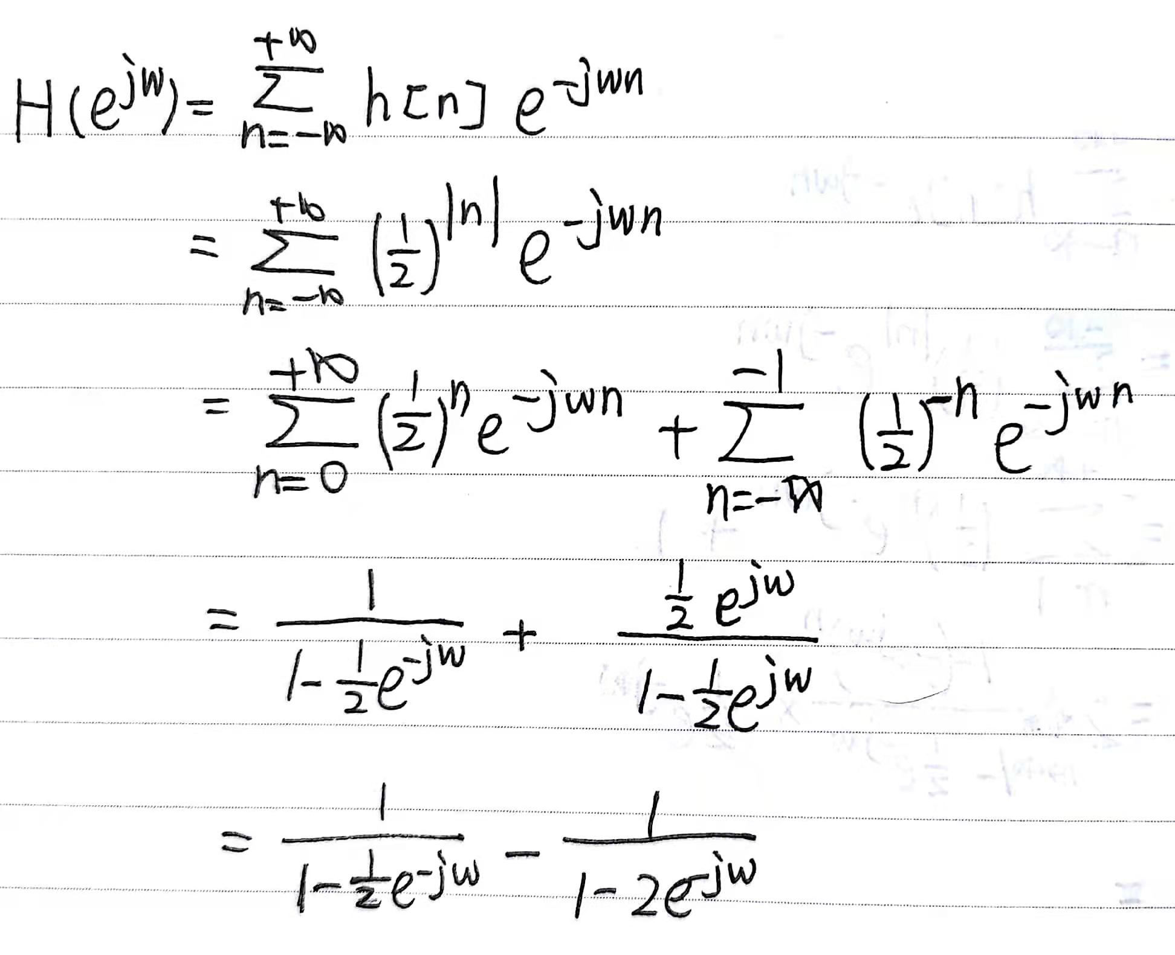
Solution 3.37

Slide 16
Solution 3.37

Slide 17
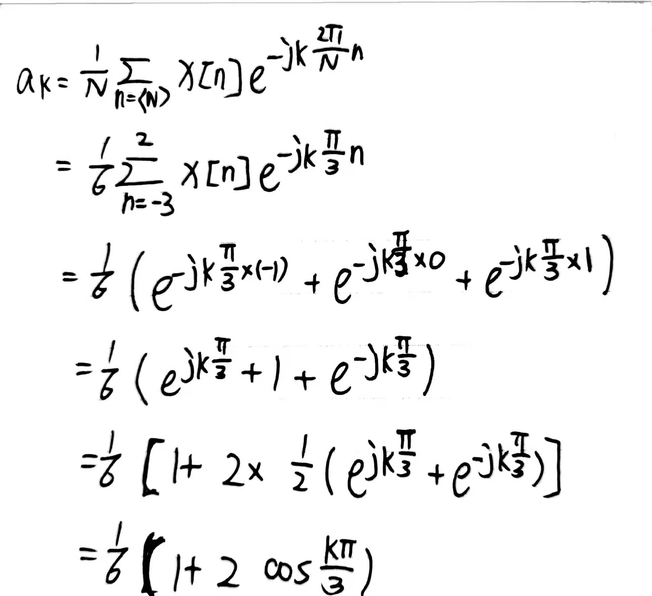
Solution 3.37

Slide 18
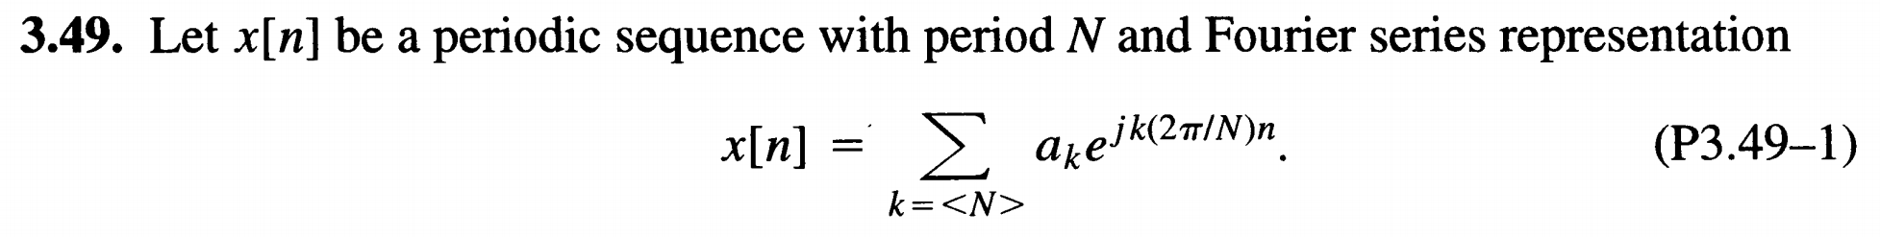
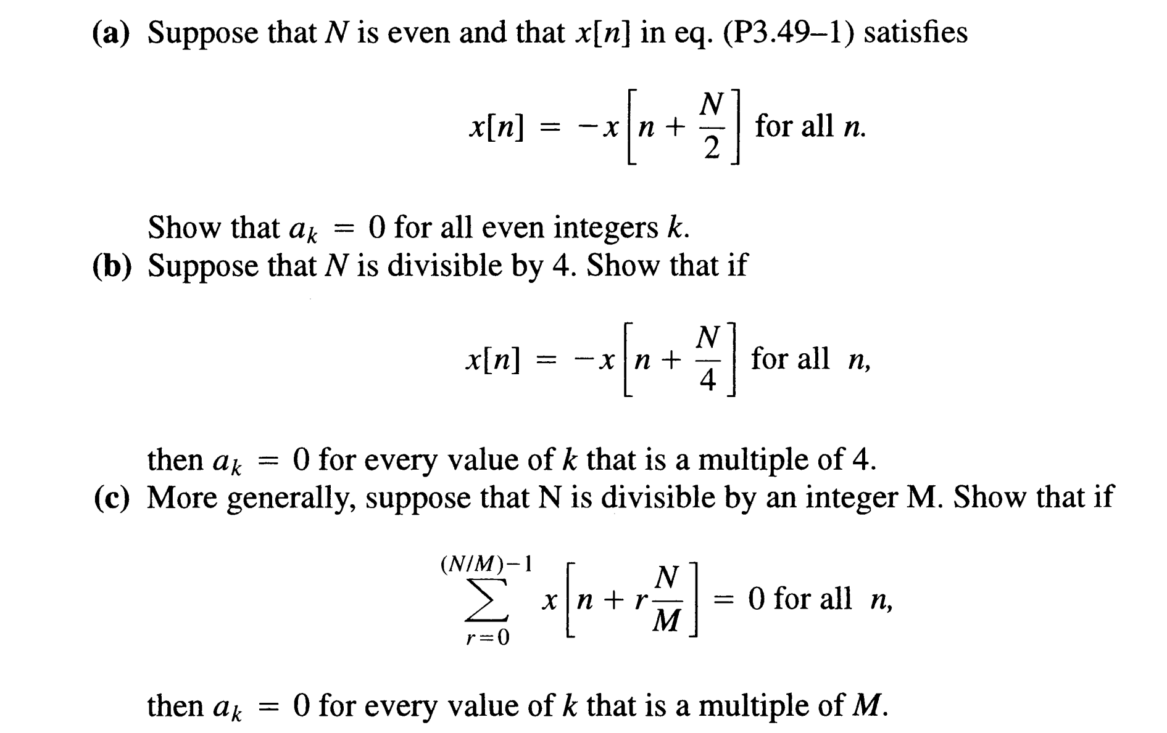

Problem 3.49
M-1

Slide 19
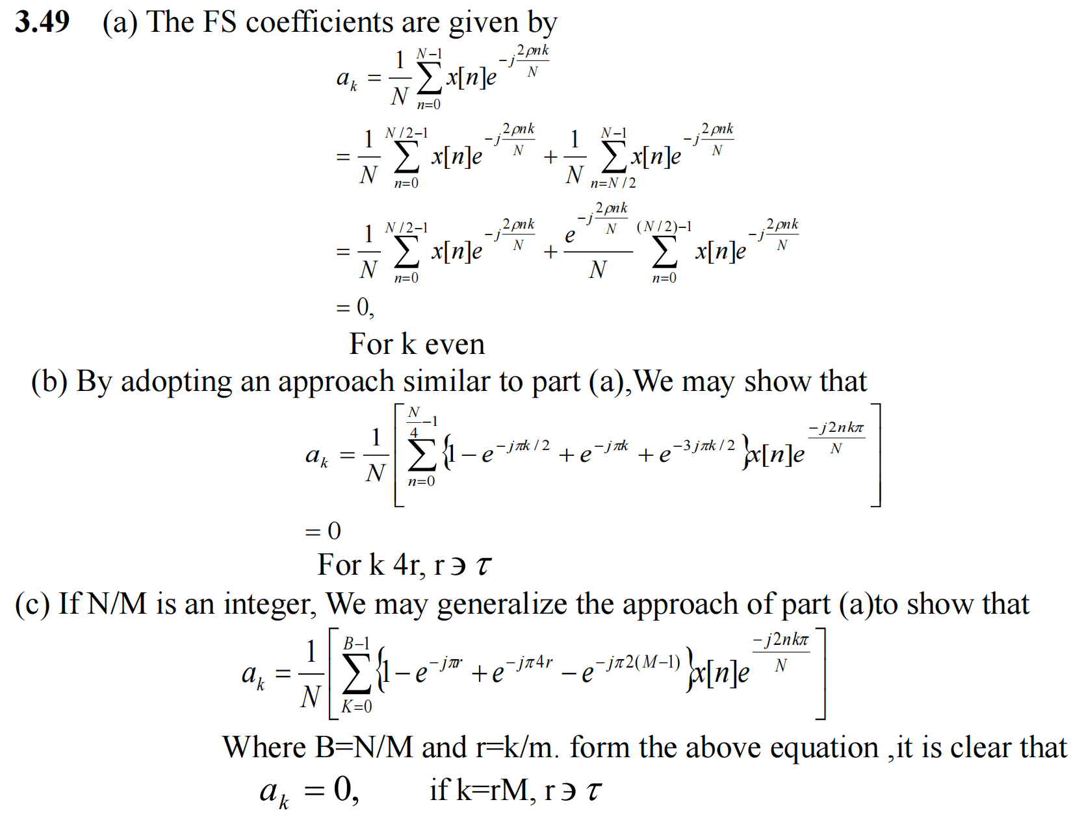




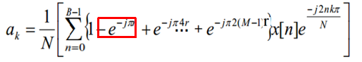
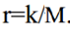
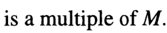
Solution 3.49
-
=
M-1

Slide 20

Solution 3.49
-
=
M-1

Slide 21
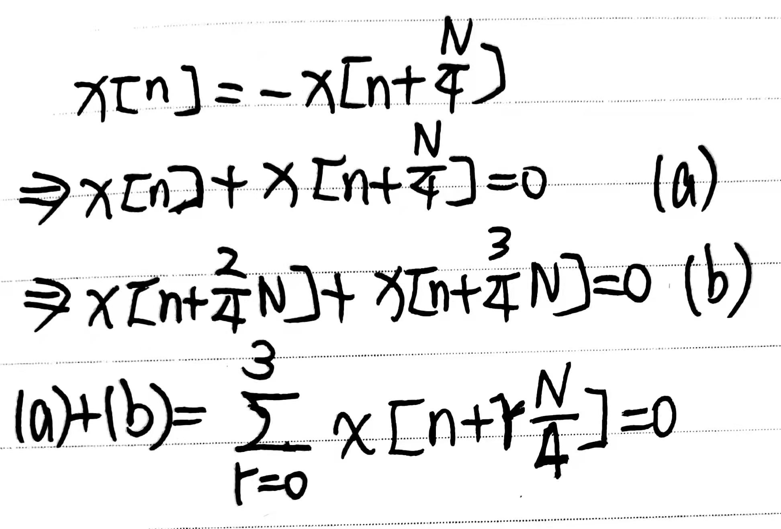
Problem 3.49
M-1

Slide 22
Solution 3.49
-
=

